Slide 1
From 5th Grade to
Middle School
The Transition

Slide 2
hello!
✋
Julie Tanen-Stevens: School Counselor
Julie_M_Tanen@mcpsmd.org
Notes:
For those of you who don’t know me, I am the school counselor here at Meadow Hall ES.. I wanted to meet with you today to give you a brief summary of the transition to Middle School.

Slide 3
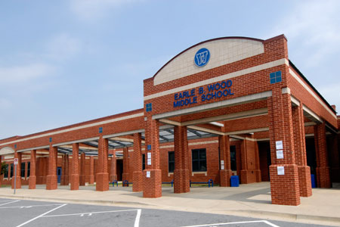
Earl B. Wood
Middle School
www.montgomeryschoolsmd.org/schools/woodms/
Notes:
As quickly as it came - our kindergarten class of 2012 is moving on to 6th grade and most of them will attend Wood Middle School!

Slide 4
Important Dates
February 14th – Wood Team & Meadow Hall Team
May 29^{th-} 5th graders will visit Wood MS
In June-
Myself & Mrs. Fernandez
Notes:
In the first week in January we met with Wood for an Articulation meeting. During that meeting we learned about classes being offered this year for incoming 6th graders. As you should have heard by now, the counselors from Wood will visit our school on Jan. 30th to help with course selection. Registration Booklets will be given out and taken home for you to review with your child. An information sheet will be sent home as well to give you details on how to register your child on-line for their 6th grade classes. The directions will be given to you in English and Spanish.
On: February 6 5th grade Parent Night
February 7 Snow Date for 5th Grade Parent Night
February 7 Open House #2 for 5th grade parents
.
Feb. 8th all registrations forms are due.
On Feb. 14th The Resource counselor, Amy Davis, the 6th grade counselor Grace Fernandez , one of the Assistant Principals, the English Content Specialist, Math Content Specialist, and the Literacy Coach will meet with our Special Educator, Reading Specialist, Staff Development Teacher, the entire 5th grade team, Admin and myself will be meeting with each other to revisit our recommendations and basically discuss what is best for each student.
In May Mrs. Fernandez .will be back to discuss any questions the students have to help ease some of the anxiety some kids may feel. In June, I will meet with Mrs. Fernandez to discuss individual student needs.

Slide 5

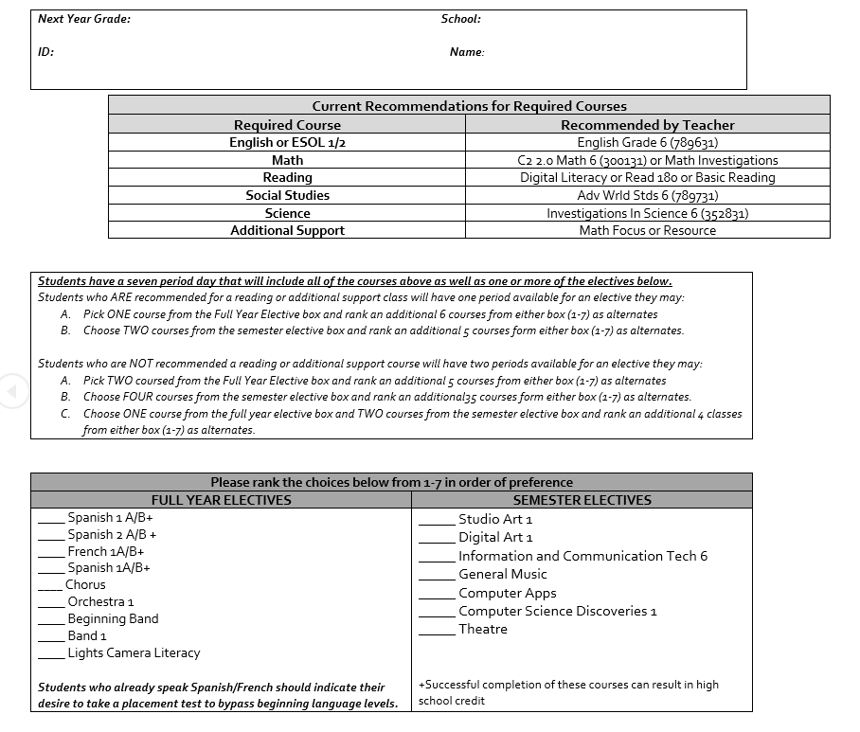
Course Selection Information
Registration Sheet
7 classes
Investigations into Science 6, Adv. World Studies 6, Adv. English 6 and PE/Health
Reading and Math levels are given by current 5th grade teacher –tentative
The electives are for the full year –indicate 1st, 2nd, 3rd choices.
Notes:
This is now all done on line! Parents do have access via the MCPS Portal. So you would sign –in to you’re the Parent Portal and enroll your child. Directions will be sent home. All students must enroll in 7 classes. Investigations into Science 6, Adv. World Studies 6, Adv. English 6 and PE/Health are automatically pre-selected, Reading and Math levels are given by current 5th grade teacher –tentative until the end of the school year. If your child is not in Reading Intervention, he/she will be enrolled in Digital Literacy. Your job as the parent is to help your child pick the elective of choice. Indicate the indicate 1st, 2nd, 3rd choices.

Slide 6
Courses
Course Description Booklet
Students enrolled in High School credit courses or IM courses are expected to maintain an A or B.
Students enrolled in world language will earn a high school credit as long as all criteria are met.
Notes:
Each child should have also take home a course description booklet and a registration sheet to be signed and returned as an additional copy in case anything happens with the system. If you didn’t receive one please contact me.

Slide 7
Information Night for Parents of
Incoming 6th Grade Students
February 6th and 7th
7:00 pm - 8:45 pm
Earle B. Wood Middle School Cafeteria
* Meet Earle B. Wood Administrators, Teachers, Counselors & PTA representatives
* Receive information on the 6th Grade curriculum, course offerings and registration procedures
* Hear from English, Science, Math, Social Studies, Arts & Technology, Health/P.E., World Languages & Special Education Content Specialists
* Learn about Middle School Transition Including Summer Orientation Programs
For more information
Contact Amy Davis, Resource Counselor
Amy_L_Davis@mcpsmd.org
Noche de Información para Padres
Notes:
So the Parent information night will be on Feb. 6th and the snow date is the 7th. However, it is also the 2nd Parent Night incase you are unable to make the Parent Night on the 6th.
If you have questions about anything or are unable to attend please contact the resource counselor Amy Davis who would be glad to answer any questions as well as help with scheduling tours.

Slide 8

PTA is having a 5th grade parent meeting/dance sometime in May -as another opportunity to be in the building and meet other incoming students.

Slide 9
5th Grade Students
You are invited to an open house at Earle B. Wood Middle School
Join us on:
Wednesday, May 29th 9:30-10:30
Busses leave at 9:15a.m.
👪
Notes:
On May 29th at 9:30 am- This is an opportunity for a true picture of what a day in Middle School is like.

Slide 10

If it’s Scary For You …
Imagine how they feel!
Making the Transition to Middle School -- How Mentoring Can Help: From the Department of Education, this guide provides plenty of tips and ideas for using mentoring to help students transition from elementary to middle school. The PDF guide includes links to helpful outside sources, as well as summaries of the best research on the subject.
Tips for Parents on a Successful Transition to Middle School: Middle school is a time of incredible growth for adolescent students, and these years have an impact on helping students gain and develop their sense of independence. This article from GoodTherapy.org offers four comprehensive tips for helping middle schoolers grow socially and emotionally.
Place your screenshot here
Notes:
So this is a happy but scary time for everyone involved. I know! I have two that went thru this and one that went thru this as an incoming 6th grader this year.. So, here are some ways I can support:
I have posted this power point along with some articles for parents to read to help them with this transition, I offer two groups that help support with the transition- one that is geared towards girls and helping them develop positive self-talk, affirmation, dealing with conflicts and team building. The other group focuses on how to deal with the stress of transitioning to Middle School. Prior to Mrs. Hernandez coming back I will have each class for a transition lesson to help with all of those fears and questions.

Slide 11
thanks!
Updated information is on my website:
http://mrsjuliestevens.weebly.com/
Any questions?
Notes:
I will post lots of information about transition as well as summer orientation on my website- Wood will have an orientation half day for all incoming students during the summer as well as the week before school starts with busses, their actual schedules and everything. So please check out my website during the summer if you haven’t received any information from Wood. You can also leave me a message on the website if you have any questions should be during the summer.

